Slide 1


Hate Speech & Toxic Comment Detection
09.12.2024
By Anjali Haryani (002839128)

Slide 2

Agenda
Overview & Introduction
Problem Description
Dataset
Solution Approach
Data Cleaning & Visualizations
Data Preprocessing
Training Models & Evaluation
Conclusion and Future Work

Slide 3


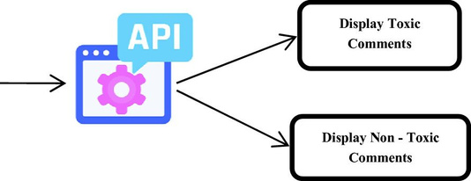
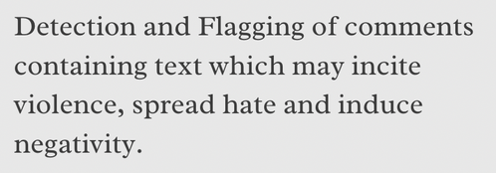

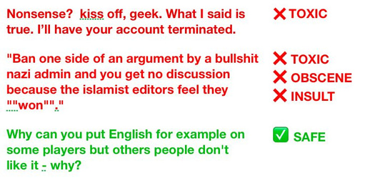
Overview

Slide 4
Introduction
In this project we aim at:
Remove toxic and hateful content to protect users.
Online bullying is a growing issue affecting many.
Abuse and harassment discourage free expression online.
Toxic comments spread negativity and harm mental health
Online bullying has become a serious issue in recent years.
Eliminating hate speech allows everyone to share their opinions freely online.

Slide 5

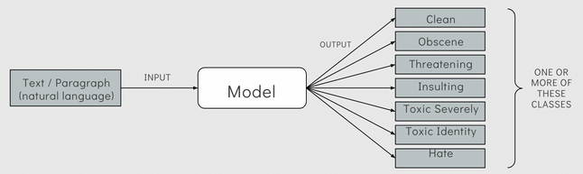


Problem Description
The goal is to classify any text as clean, obscene, threatening, insulting, toxic, severely toxic, or identity hate.

Slide 6

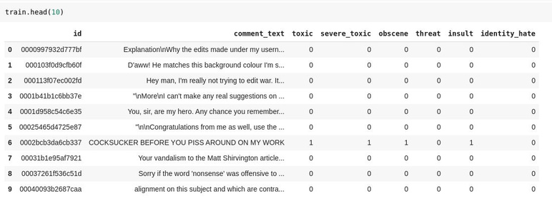
Dataset
Data from Conversation AI (Jigsaw and Google) to study negative behaviors.
The dataset has Wikipedia comments labeled for six types of toxicity
It includes 143,346 non-toxic and 16,225 toxic comments
Labels were manually assigned by human raters on Kaggle.

Slide 7

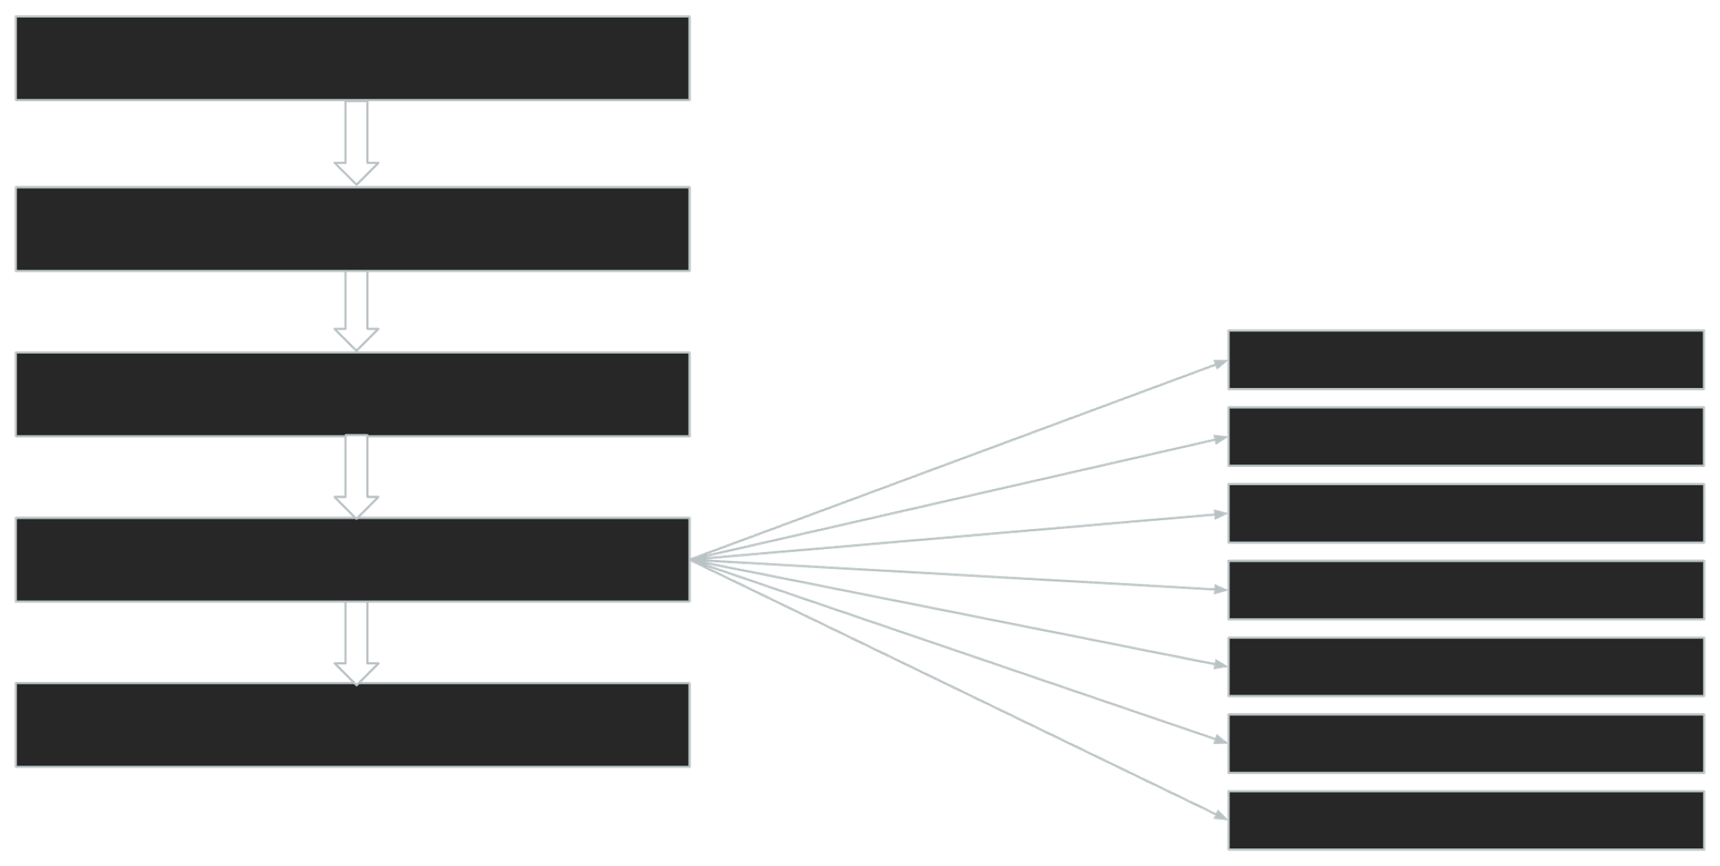
Solution Approach
Dataset
Conversational AI
Data Cleaning & Visualization
Get qualitative high-level insights into the data
Models with Embeddings
LSTM
LSTM with Glove
Bi-LSTM
Bi-LSTM with Glove
CNN+LSTM
CNN+LSTM with Glove
Data Pre-processing
Remove punctuations, stop words, stemming, etc.
Training the model
Conclusion & Results
Best Model Suggestion & Results

Slide 8
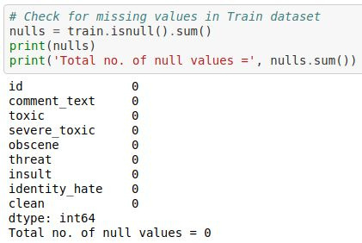



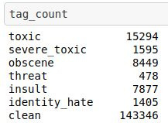


Data Cleaning & Visualization
Checking for missing values.
Adding extra column for ‘clean’ comments.

Slide 9

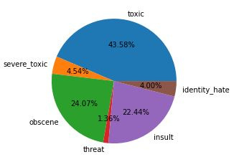

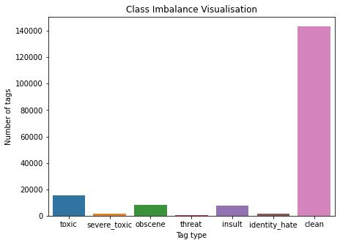


Data Cleaning & Visualization
Class Imbalance: Toxicity is unevenly distributed across classes; 'toxic' tags make up 43.58%, while 'threat' tags are only 1.36%.
Of the total ~160k comments, about ~140k are clean.

Slide 10

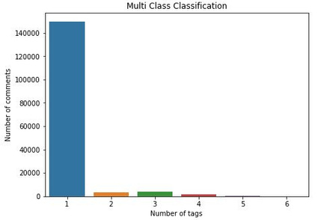

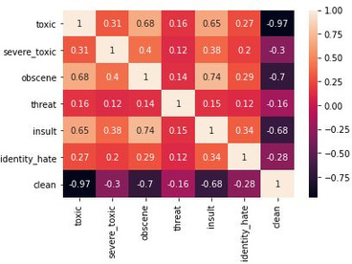


Data Cleaning & Visualization
Multi-class classiﬁcation: Many comments have only one tag, but some comments have 5 or 6 hate tags.
Heatmap showing the correlation between tags.

Slide 11



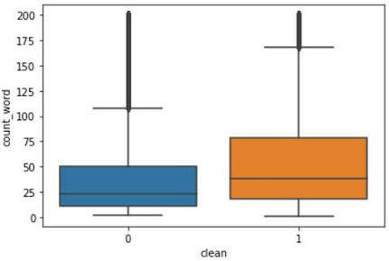
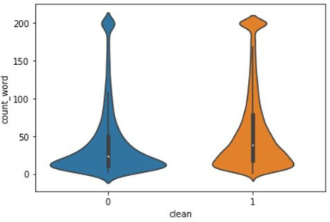
Data Cleaning & Visualization
Are longer words more toxic?
Violin Plot
Box Plot
Slight correlation is observed. Lesser words increase the chances of toxicity.

Slide 12
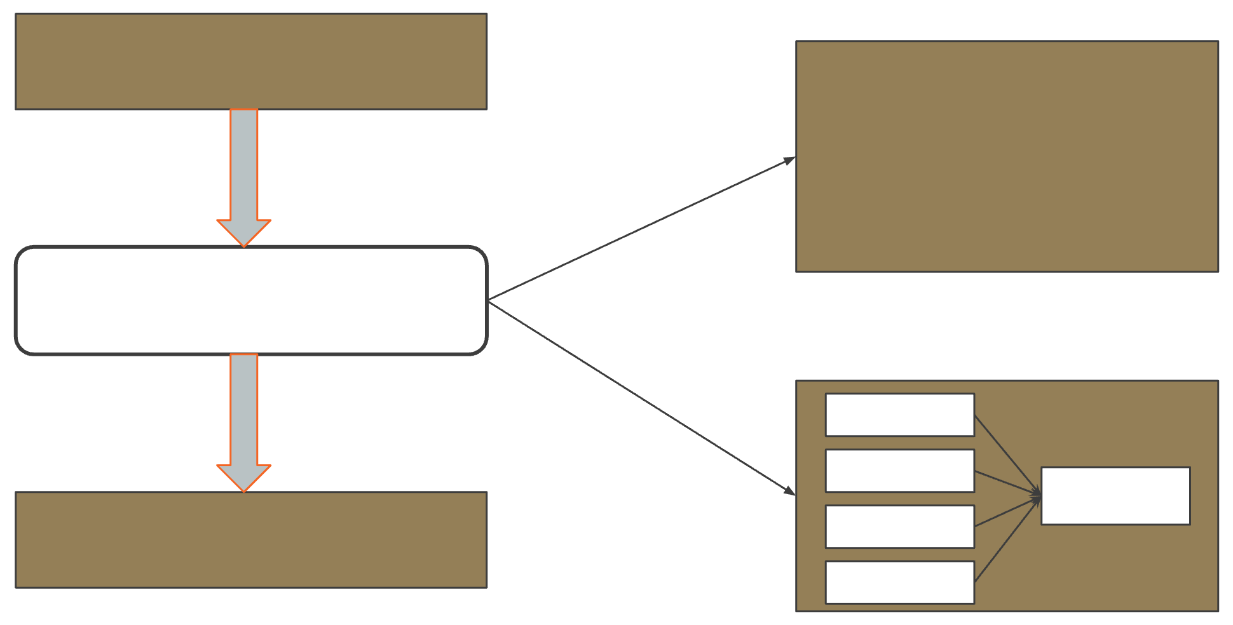


Data Preprocessing
Cleaned Data
out, what, most, any, off, too, have, more, or, the, ours, both, whom, and, of, aren, her, does, from, if, not, own, this, it, a, it's, hers, why, who, now, been, me, ...
STOP WORDS
Data Preprocessing
argue argued argues arguing
argu
STEMMING
Machine Readable Format

Slide 13

Data Preprocessing
Converting cleaned data into a machine-readable format.
Stop Words
Common words (e.g., "the," "and") often removed in NLP.
They add little meaning and can clutter analysis.
Libraries like NLTK provide built-in lists of stop words.

Slide 14

Data Preprocessing
Stemming
Stemming reduces words to their root form (e.g., "running" to "run").
It simplifies text and reduces vocabulary size in NLP.
Focuses analysis on core word meanings.
Libraries like NLTK's PorterStemmer in Python offer stemming tools

Slide 15

Data Preprocessing
hey man i m really not trying to edit war it s just that this guy is constantly removing relevant information and talking to me through edits instead of my talk page he seems to care more about the formatting than the actual info
hey man realli tri edit war guy constantli remov relev inform talk edit instead talk page seem care
DATA PREPROCESSING
format actual info
CLEANED COMMENT
COMMENT IN MACHINE READABLE FORM

Slide 16

Training Models & Evaluation

Slide 17

Models and Embeddings
Models Used
We used sequential deep learning models: LSTM, Bi-LSTM, and CNN + LSTM for text classification.
These models belong to the family of Recurrent Neural Networks (RNNs), designed to process sequential data.
Word Embeddings
Word embeddings are vector representations of words, capturing semantic relationships.
We used GloVe, a pretrained embedding technique, to enhance word understanding by learning word co-occurrence patterns in large datasets.

Slide 18
Evaluation
Focus on AUC-ROC and Accuracy:
We prioritized these metrics for evaluating model performance.
AUC-ROC Score:
Important for assessing model performance across various thresholds.
Particularly valuable for imbalanced datasets as it evaluates the ability to distinguish between classes.
Accuracy:
Provides an overall measure of correct classifications.
Helps to understand the model's general performance in predicting the right classes.
Word Embeddings
Word embeddings are vector representations of words, capturing semantic relationships.
We used GloVe, a pretrained embedding technique, to enhance word understanding by learning word co-occurrence patterns in large datasets.

Slide 19
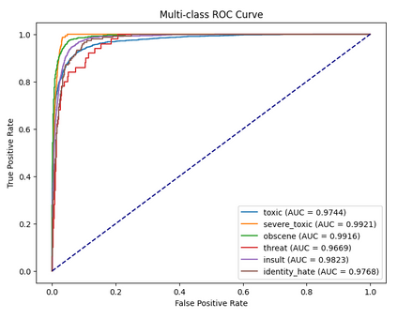

LSTM
Processes text sequentially, capturing word order and context.
Works well with softmax for multi-class tasks.
LSTM achieved a high ROC-AUC score of 0.980
Achieved and approximate validation accuracy of 92%.

Slide 20
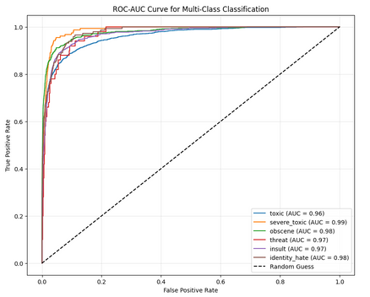

LSTM with Glove Embedding
Utilizes GloVe for semantic-rich embeddings and better context.
Generalizes well on unseen data with pre-trained embeddings.
LSTM + Glove achieved a high ROC-AUC score of 0.9741.
Achieved and validation accuracy of 91.6%.

Slide 21

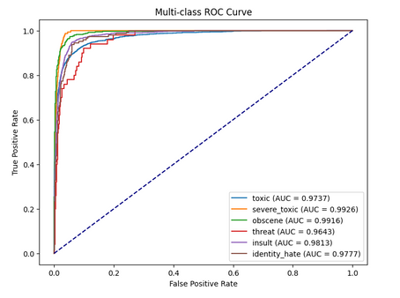

Bi-LSTM
Processes text in both forward and backward directions.
Captures dependencies from past and future words.
Bi-LSTM achieved a high ROC-AUC score of 0.98.
Achieved and validation accuracy of 91.7%.

Slide 22
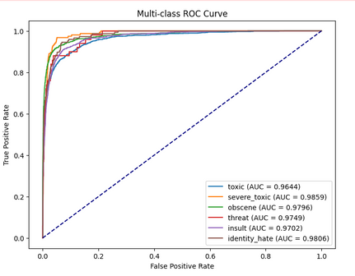

Bi-LSTM with Glove Embedding
Utilizes Glove for semantic-rich embeddings and better context
Bi-LSTM + Glove achieved a high ROC-AUC score of 0.9759.
Achieved and validation accuracy of 91.3%.

Slide 23
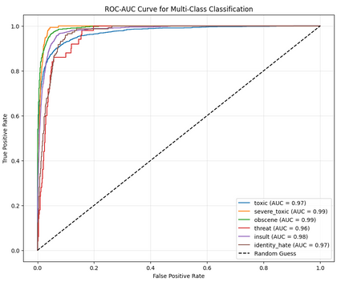

CNN + LSTM
CNN captures patterns, LSTM adds context for robust classification.
CNN + LSTM achieved a high ROC-AUC score of 0.9774.
Achieved and validation accuracy of 91.6%.

Slide 24
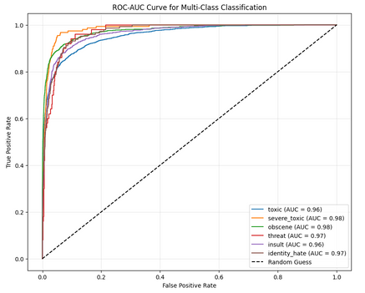
CNN + LSTM with Glove Embedding
GloVe provides semantics, CNN captures patterns, and LSTM learns sequences.
CNN + LSTM + Glove achieved a high ROC-AUC score of 0.9759.
Achieved and validation accuracy of 91.21%.

Slide 25
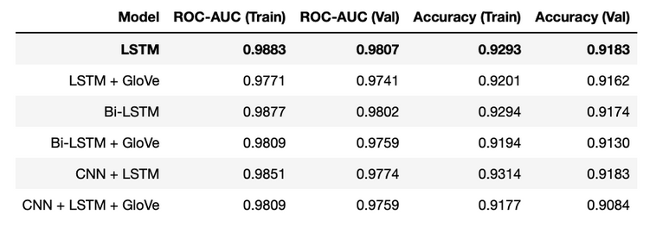
Best Model
LSTM is ideal for its balanced precision-recall, high ROC-AUC (0.9807), and strong accuracy (91.83%).

Slide 26
Conclusion
LSTM proved to be the best choice.
Sequential Strength: LSTM excels in capturing long-range dependencies.
Effective Learning: LSTM outperformed combined models, even without embeddings.
Reliable Metrics: Multiple metrics ensured reliable model selection for imbalanced dataset.
Simplicity: Simple LSTM outperformed more complex models.

Slide 27
Future Works
Data Labeling: Manual labeling may introduce bias and inconsistency.
Noisy Data: Addressing slangs and spam can boost performance.
Unbalanced Dataset: Use data augmentation to handle class imbalance.
Memory Issues: Implement batching and caching to manage large datasets.
Advanced Models: Experiment with Transformer-based models for improved context.

Slide 28

Thank You.

